Slide 1
CREDIT CARD ANALYSIS
Group Members
Rohit Pradhan Tushar Singh Sneha Khandale

Slide 2
Introduction
Data-driven insights are essential for improving client experiences and guiding strategic decisions in the ever-changing banking industry. This research explores a bank's whole dataset, offering insightful insights into the bank's customer base, credit card dynamics, account trends, and transaction patterns. By unraveling the trends and preferences within the client base, the bank gains valuable informations that can inform future strategies, product offerings, and customer engagement initiatives.

Slide 3
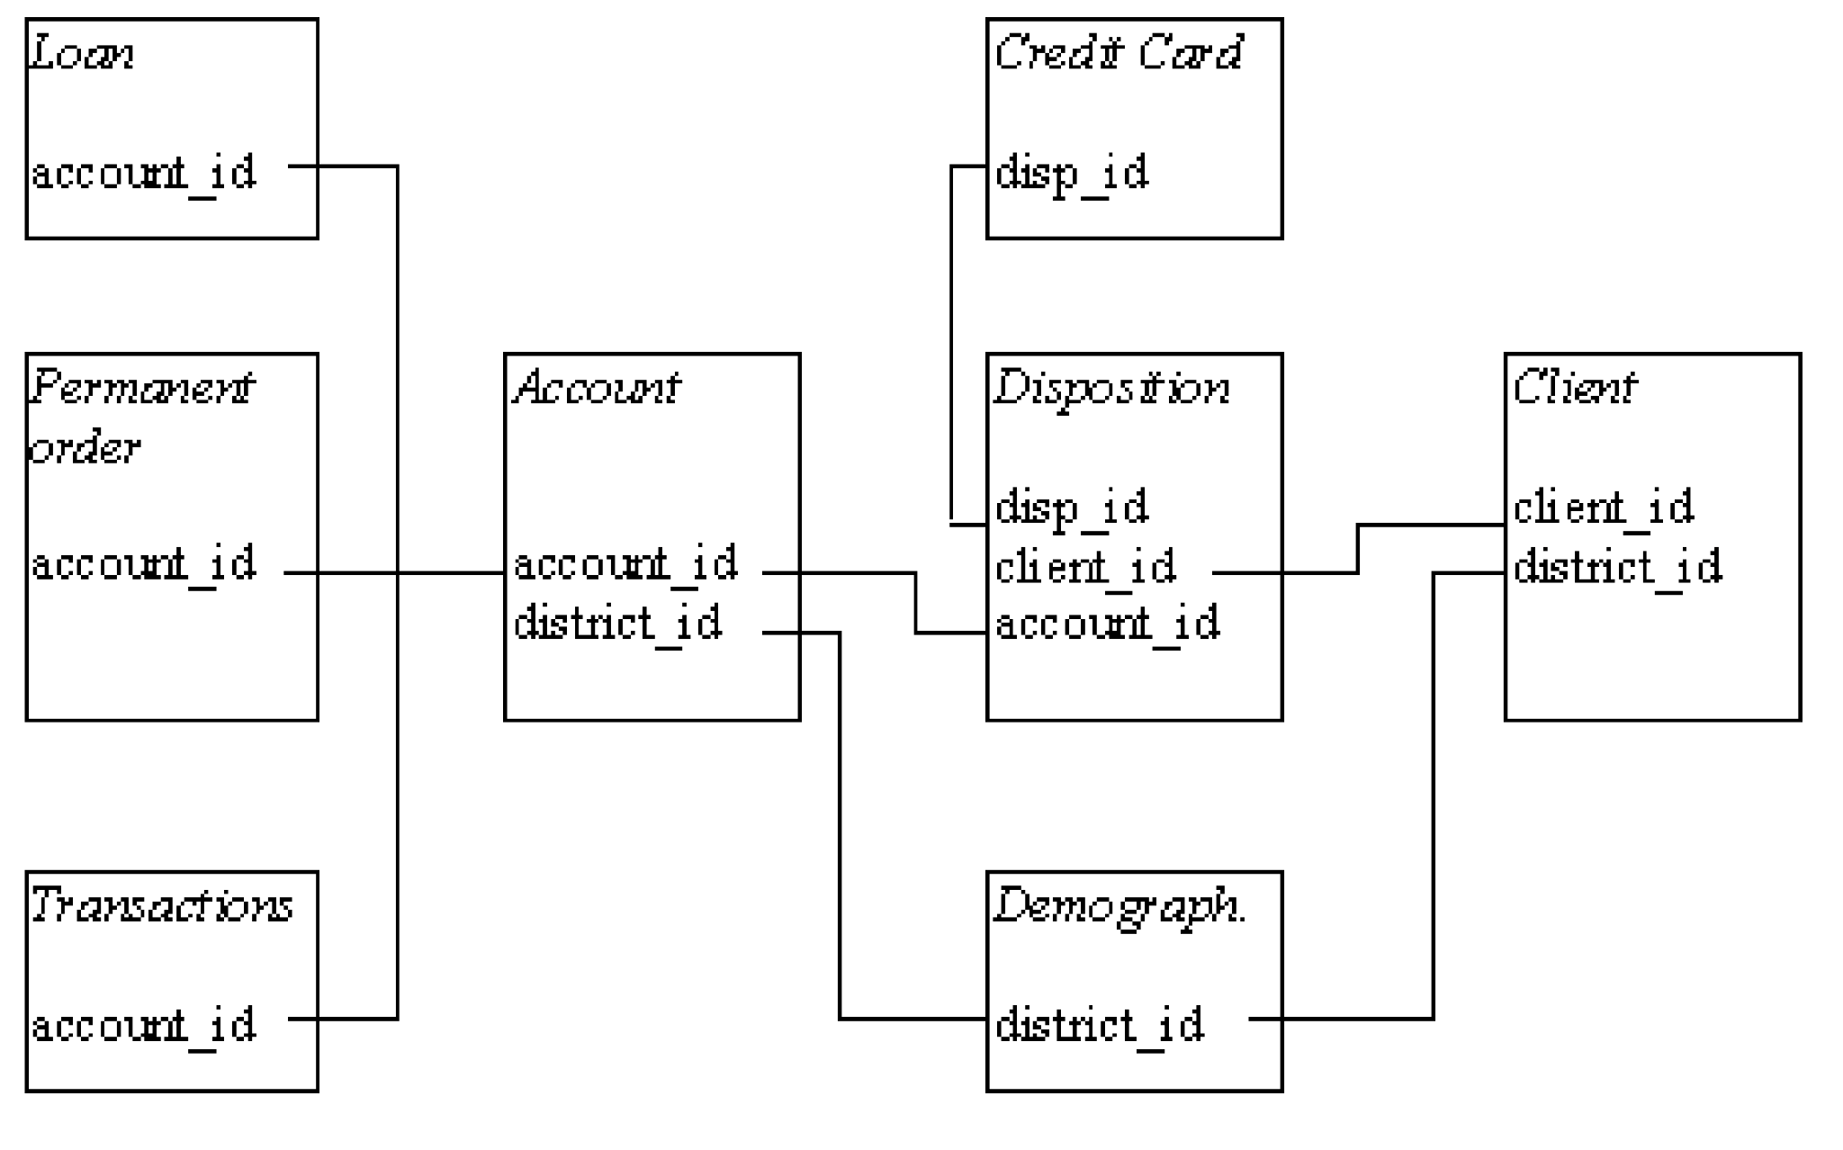
ER diagram

Slide 4
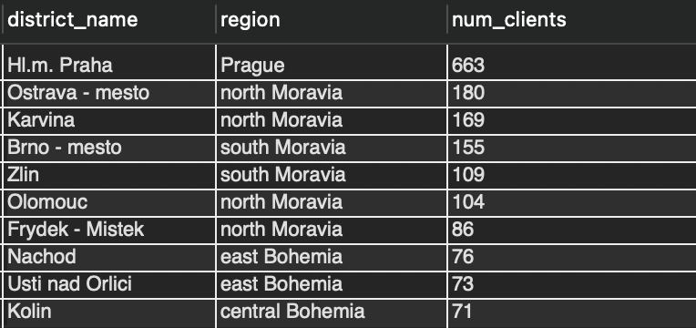
TOP 10 DISTRICT WITH HIGHEST NUMBER OF ACCOUNTS

Slide 5
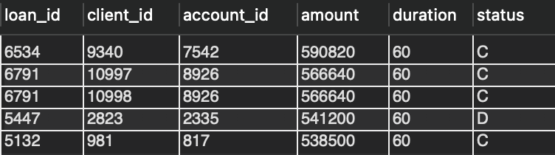
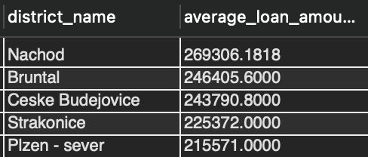
Top 5 Loans with Highest Amounts and Corresponding Client_id.
Top 5 Districts with the Highest Average Loan Amounts:

Slide 6
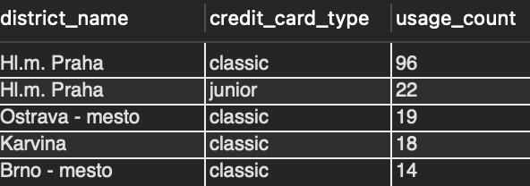
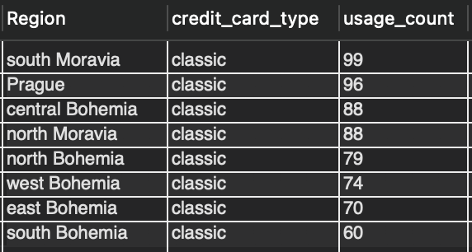
Top 5 Credit card used more according to district corresponding usages count
Ranking Credit Cards by Usage Count Within Each REGION:

Slide 7
Conclusion
The bank's data provides valuable insights into its client base and operational trends. With a substantial clientele of 5,369 individuals, the bank has issued a diverse range of 892 credit cards, prominently featuring the 'Classic Card' with 659 issuances. The gender distribution is relatively balanced, with 2,724 male clients and 2,645 female clients. The highest surge in account openings occurred in the year 1996, totaling 1,363.
These insights indicate a robust and active client engagement during that period. The preference for the 'Classic Card' suggests a consistent trend in client choices. Furthermore, the bank experienced a notable peak in transaction volumes during January, totaling 122,214 transactions.
This could be attributed to various factors such as seasonal spending patterns or specific promotions. Overall, these insights equip the bank with valuable information to refine its strategies, tailor services, and enhance customer satisfaction by aligning offerings with client preferences and optimizing operational efficiency.

Slide 8
Future Scope
The bank could delve deeper into understanding the factors driving the popularity of the 'Classic Card' and leverage this information to introduce tailored credit card offerings that align with evolving customer preferences.
Exploring the reasons behind the peak in account openings in 1996 could uncover specific market conditions or promotional strategies that were successful, informing the bank's future marketing efforts. Additionally, the bank might consider implementing targeted campaigns to increase credit card issuance, capitalizing on the existing diversity in card types.
Further analysis of transaction patterns, especially during the peak month of January, could uncover seasonal trends or specific events that influence customer spending.
Implementing data-driven strategies to enhance customer engagement, introduce innovative financial products, and optimize operational efficiency would be key aspects of the bank's future growth and success.

